Slide 1
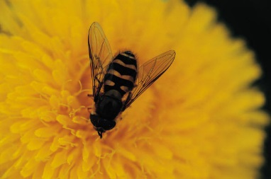
Bees
… and why we need to
care about them!

Slide 2
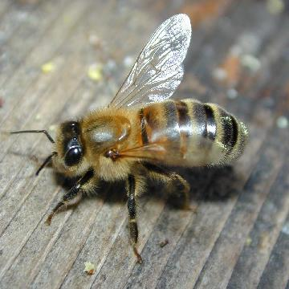
Bees are insects.
They have a three part body and six legs. They also have 2 pairs of wings.
A honey bee

Slide 3
How many different bees are there?
There are about 260 species of bee in the United Kingdom.
Only one is a honey bee.
There are about 17 Bumble Bee species. Honey bees and bumble bees are social bees and live as colonies.
The other 230 types of bees are solitary, which means they live on their own.

Slide 4
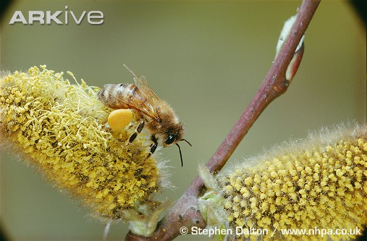
What do bees eat?
Adult bees forage for pollen and nectar, the sweet liquid produced by flowers.
They feed the pollen to the young grubs in the hive or nest. Pollen has lots of protein.
Adult bees use nectar to make honey in the hive. Honey is stored
for winter.

Slide 5
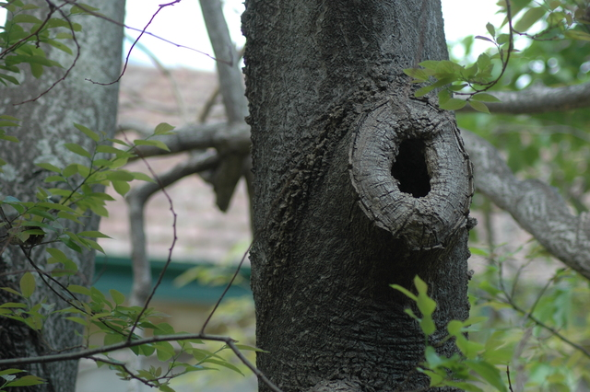
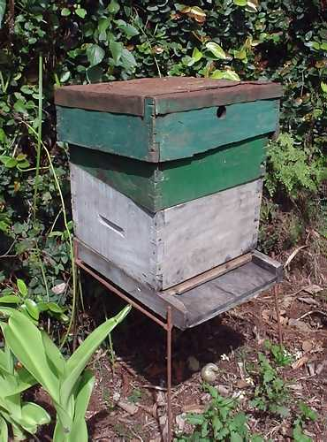
Where do bees live?
Honey bees in the wild
make their nests in
trees, sometimes using
holes in trunks or branches
People keep honey bees
in bee hives which are
usually made from wood.

Slide 6
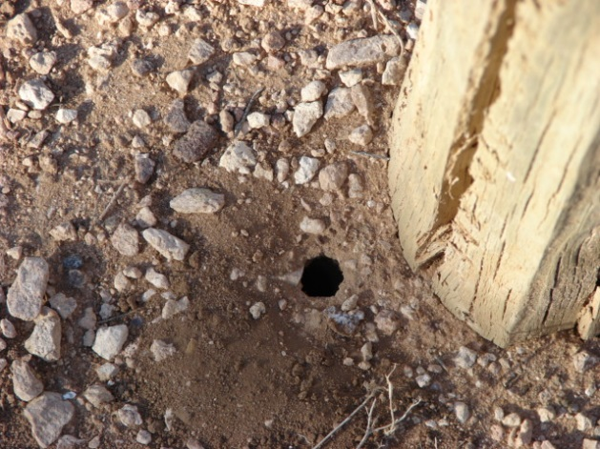
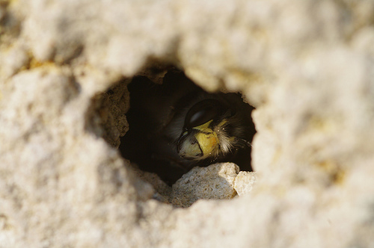
Where do bees live?
Bumble bees make small
nests, often in the ground.
Solitary bees live in
lots of places, including
in a hole in a wall or in
the lawn.

Slide 7
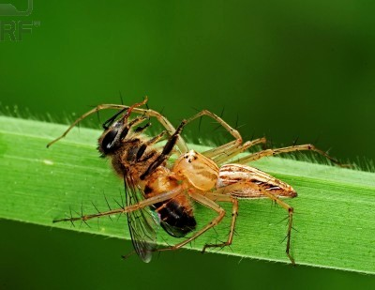
What eats bees?
Lots of animals, large or small, eat bees:
Birds
Spiders
Wasps or ants
Grasshoppers and crickets
Bigger animals like bears
My dog tries to catch bees!
Humans kill bees, sometimes deliberately and sometimes by accident when using sprays in the garden.

Slide 8
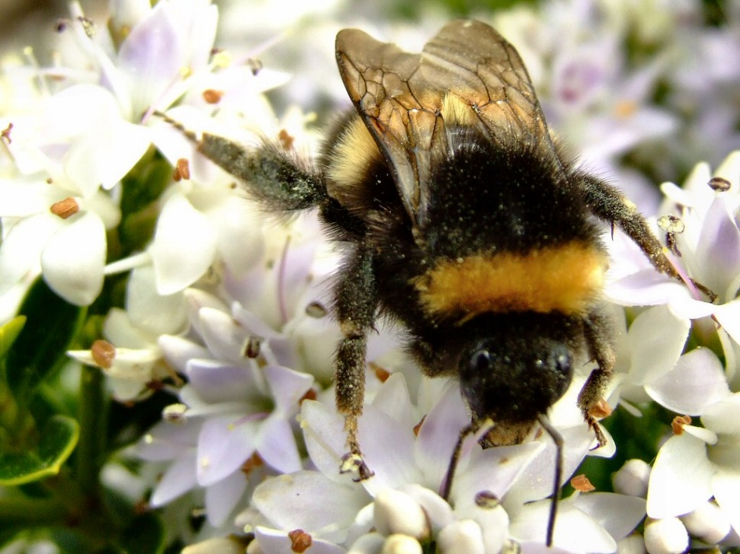
Bumble Bees – the gentle bee
Bumble bees are not the
same as honey bees.
They only make a
tiny bit of honey,
enough to feed
their young.

Slide 9
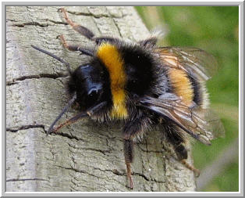
Bumble Bees (cont.)
They are round and furry
and fly a lot more slowly
than honey bees.
They rarely use their
sting, and do not die
when they do use it.

Slide 10
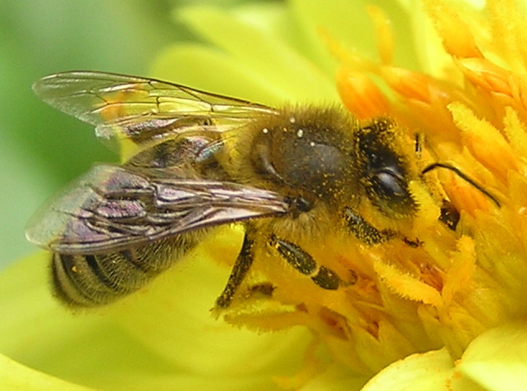
Honey Bees
How many types of honey bee are there?
Honey bees are
very busy bees.
They live in colonies
with lots of other honey
bees – many thousands.
Bees make and store honey to
eat in autumn and winter.
They make so much honey that people can take
some without harming the bee colony.

Slide 11
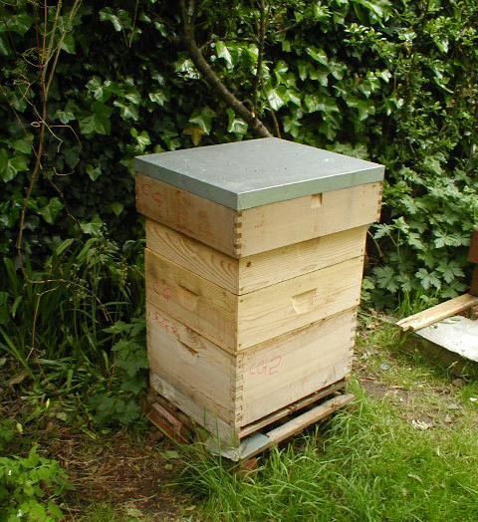
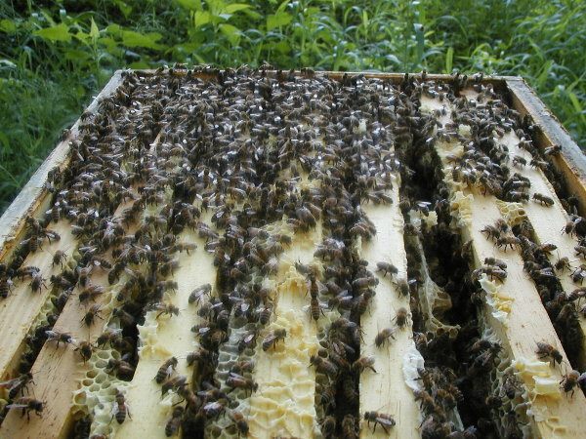
A honey bee hive
The hive Inside the hive

Slide 12
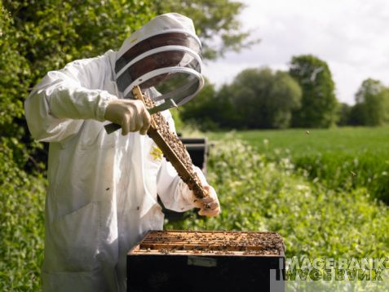
Collecting honey from the hive
You must wear protective clothes!

Slide 13
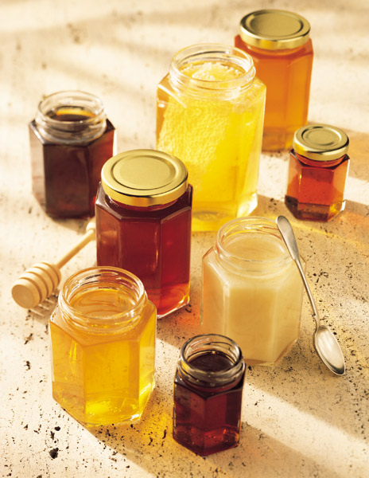
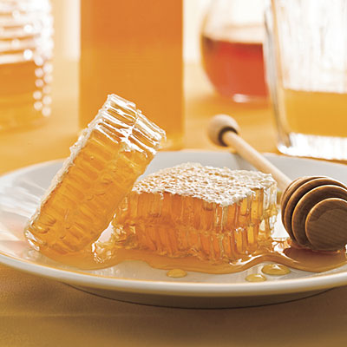
Do you like honey?
Jars of honey honeycomb

Slide 14
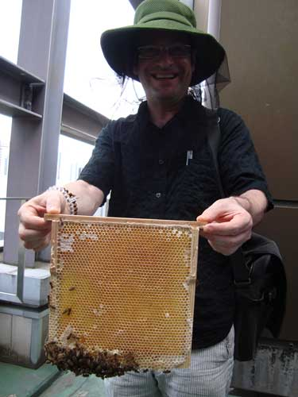
What shape are honeycomb cells?
Inside the hive, the honey bees raise their young in cells.
Each egg is laid
in its own cell.

Slide 15
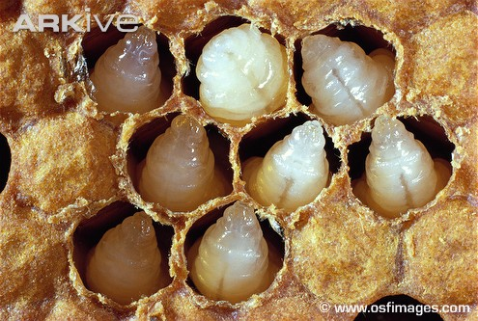
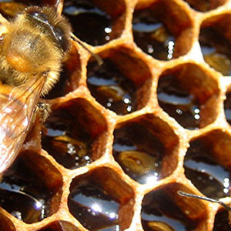
The grub hatches and grows in the cell.
Worker bees feed the grubs with pollen.

Slide 16
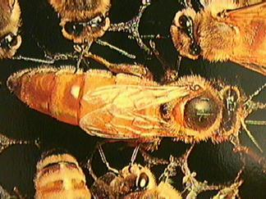
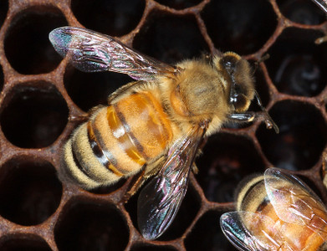
What types of bee are in a hive?
There are 3 types of bee:
The Queen – only 1 of these
Drones – males who do no
work
Workers, all females, who
keep the hive tidy and fly
out to find pollen and nectar

Slide 17
How do bees find food?
When a worker bee is about 3 weeks old she can fly out of the nest to find flowers to collect nectar and pollen from.
When she finds a good source of nectar she flies back to the hive and does a ‘waggle dance’.
This tells other worker bees where to fly to find the good source of food.

Slide 18
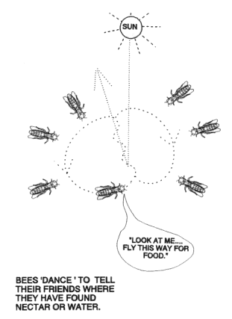
The Waggle Dance

Slide 19
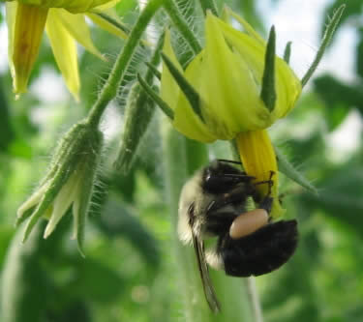
Here is the really important bit!
Why are we worried about bees?
Bees are dying out. This is a problem for us.
Besides feeding themselves when they collect pollen, bees do a very important job.
They pollinate many, many
of the plants we eat.

Slide 20
How does that affect us?
Bees of all types pollinate more than half of the plants that grow food for us.
If bees did not pollinate these plants, no fruits or seeds would develop.
That means no apples, no pears, no tomatoes, no cherries, no strawberries, no cucumbers, no nuts, no beans, no……….

Slide 21
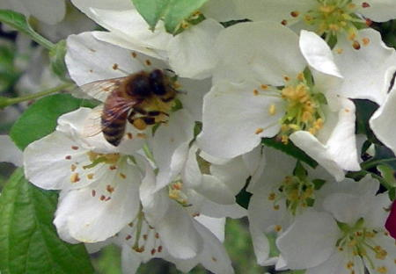
How can we help look after bees?
1) Be a friend to bees – they are not bad for us. If a bee is bothering you, stand still and it will go away.
Don’t be scared of wild bees in the garden. Never harm a bees nest.
Plant lots of flowers so
bees can find lots of food.
Join the BBC Radio Suffolk
‘Bee Part of It’ campaign. http://www.bbc.co.uk/breathingplaces/beepartofit/

